Slide 1

Adaptive Machine Learning for Enhanced DDos Detection
Presented by group 8

Slide 2
Introduction
Software Defining Networks separate the hardware and control logic to transform conventional network administration
Benefits of SDN are its Enhanced agility, cost efficiency and centralized control
SDN’s are ideal for dynamic environment requiring frequent configuration changes.
In todays digitally connected world, the use of IoT technology has revolutionized traditional methods
Impact of IoTs drives automation and efficiency in industries such as healthcare, smart homes, and agriculture.
Challenges raises in security and privacy concerns.

Slide 3
DDos Attacks
Distributed denial of service ( DDos) attacks attempts to interfere with regular network operations by flooding the target with excessive internet traffic.
Can severely impair network functionality by taking use of the ability of numerous compromised computer systems to impact the targeted serves as well as the associated infrastructure.
Leads to downtime and accessibility issues.
Need to robust security measures.

Slide 4
Problem Formulation
Traditional DDos detection are rule-based and static. It detects attacks based on traffic volume of the attack and sends an alert.
Limitations of rule based are not identifying low-scale attacks.
To mitigate we aim to develop adaptive ML models that only detects but learns from evolving behaviours for enhanced and proactive detection from ongoing data and adjusting to new threats in real-time.
Adaptive machine learning improves detection rates and reduce false positives. This is essential to protect SDN and IoT environments.

Slide 5
Data Collection
Dataset : NetBIOS dataset which was made openly available by the University of New Brunswick, Canada
It has 3.4 million rows and 88 columns in total, Target label is included.
The stats on network traffic and the logs of the event were made available for all the events.
The columns in the dataset included Destination Port, Flow-based features, packet-based features, and Flag counts.

Slide 6
Data Understanding
Duplicates: There were no duplicates in the dataset.
Missing values detection: The analysis of the dataset revealed a total of 6 missing values.
Inf values detection: Data has inf values of 130555.
Outliers detection: outliers are present and could affect the performance of model.
Imbalance Label column: This could make the classification modeling biased. To overcome this we have applied undersampling and SMOTE techniques.
To identify distribution and understand the spread we have plotted visualization graphs for features like .

Slide 7
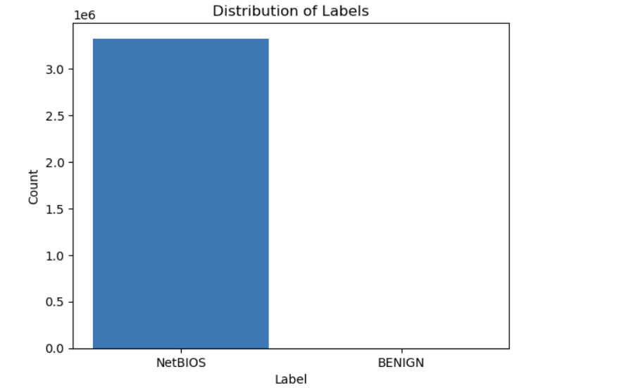
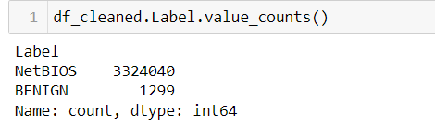
EDA

Slide 8
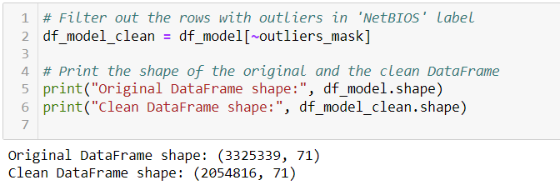
Data Preparation
Handled missing values: By removing rows with missing values.
Handled outliers:
Identified and Removed the outliers to prevent skewing the analysis.
Capped the outliers after removing few outliers to reduce the impact.
Label Encoding: converted categorical labels to numerical values.

Slide 9
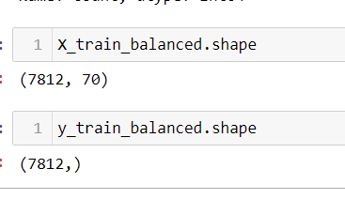

Data preparation Cont’d
Handled Imbalance Data: Random Undersampling and SMOTE( Synthetic Minority Over-Sampling technique)
After performing balancing techniques size of data frame
Normalized the data using MinMaxScalar
Using Standard Scalar, standardize the data.
Performed Dimensionality Reduction Technique with PCA to retain most of variance. Set n_components = 0.95.
Split the data into training and testing sets in ratio of 80:20 using train_test_split.
Random state is fixed ( random state = 42)

Slide 10
Modeling
MODELS
Logistic Regression
Random Forest Classifier
KNN Classifier
XGBoost
SVM
Decision Trees
Evaluation Metrics
Accuracy
Confusion Matrix
Recall
Precision

Slide 11
Logistic Regression
Logistic Regression is the statistical model that is used mainly for binary classifications.
Predicts the probability of a binary outcome using a sigmoid function.
Very suitable if the Label is categorical.
Linear Decision Boundary
To prevent overfitting we can add a penalty to large coefficients to prevent overfitting
Build a baseline Logistic regression model and L2 regularization(Ridge) model to balance the trade-off between bias and variance improving the model’s performance.

Slide 12
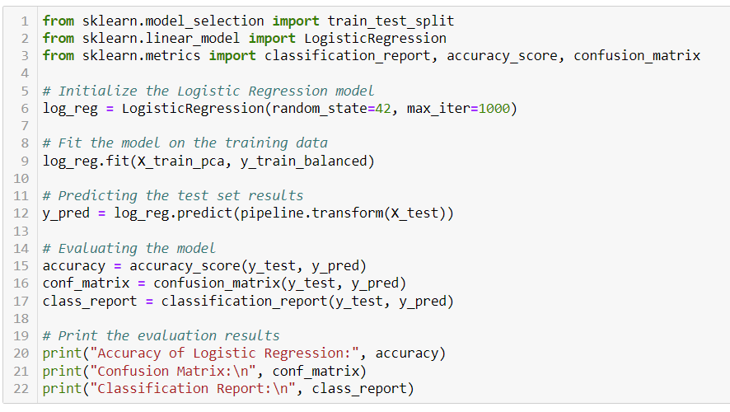
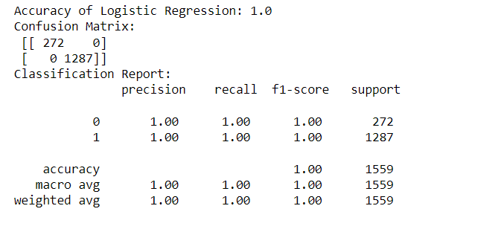
Code and Evaluation before regularization
Before Regularization

Slide 13
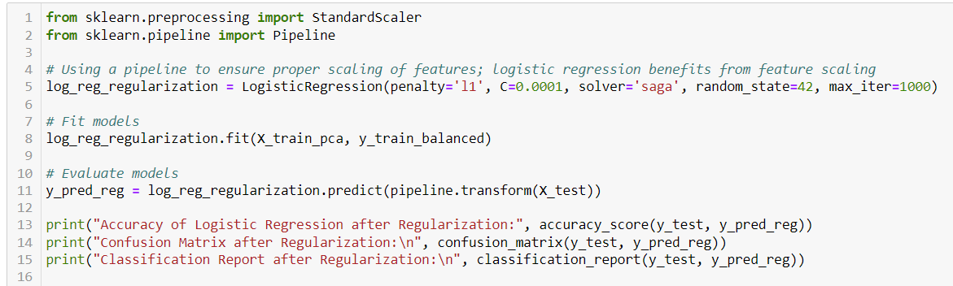
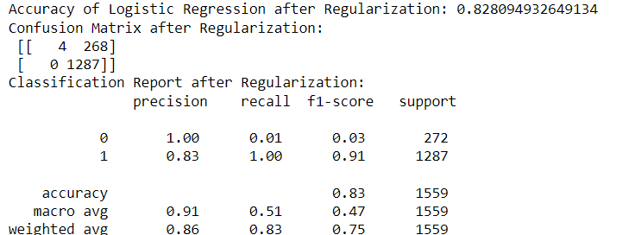
After Regularization

Slide 14
Random Forest Classifier
Random Forest is an Ensemble Learning Method used for classification as well. In this method, a multitude of decision trees are built during training and majority class is output for the classification.
Essential Python libraries such as sklearn.ensemble for RandomForestClassifier.
Advantages of Random Forest Classifier are Accuracy and performance, Robust to overfitting, Handling Large datasets with Higher dimensionality, etc.
Disadvantages are complexity, interpretability, memory usage, performance issues and prediction time.
We have build baseline model with fixed parameters n_estimators =10 and max_depth=10
To get better accuracy and improve model performance tuned the hyperparameters using RandomSearchCV.

Slide 15
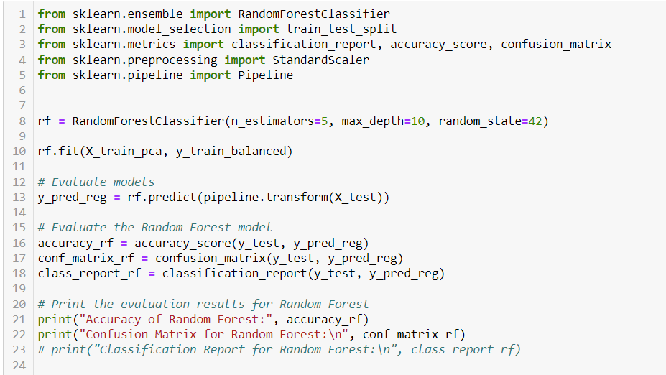
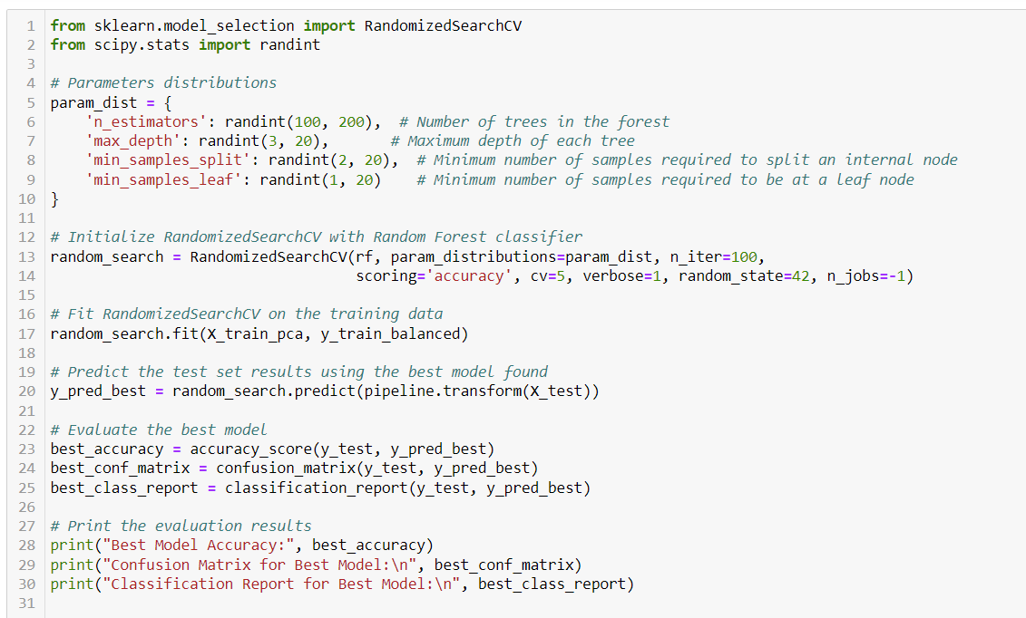
Code for random forest baseline and hypertuned model
For baseline Model
For hyperparameter-tuned model

Slide 16
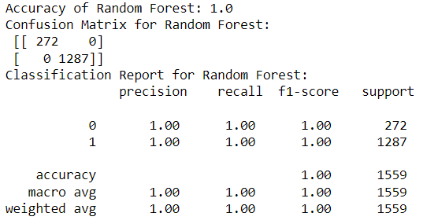
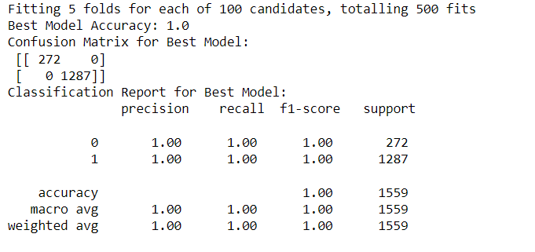
Evaluations for Random Forest
For baseline model
For hyperparameter-tuned model

Slide 17
KNN classification
KNN is simple but powerful algorithm used in supervised learning for classification. It predicts the class of a given data point based on majority votes for its nearest neighbors.
Key features are no training phase or it is minimal which means that model does not learn parameters to make predictions, it used entire dataset as the model.
Necessary libraries in python are sklearn.neighbors for importing KNN classifier.
Advantages are high accuracy and precision, practical uses in real-world applications.
Limitations of KNN are computationally expensive, sensitive to noise data, choosing the number of neighbors and appropriate distance metric.

Slide 18
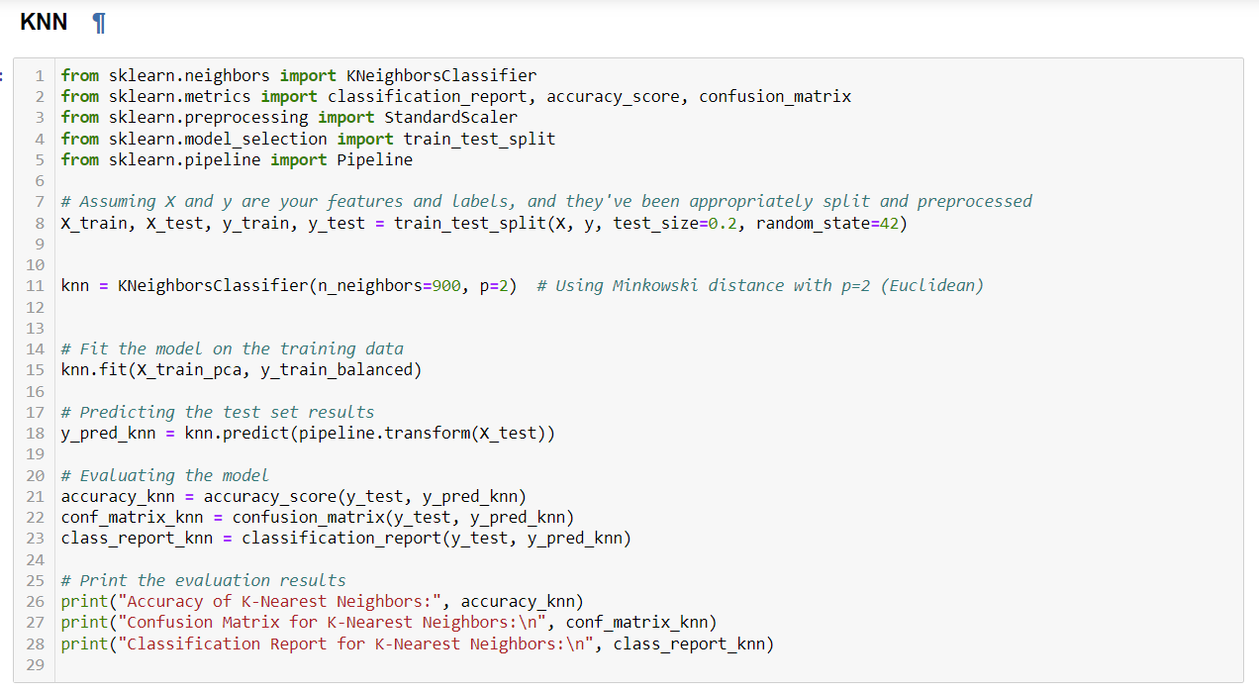
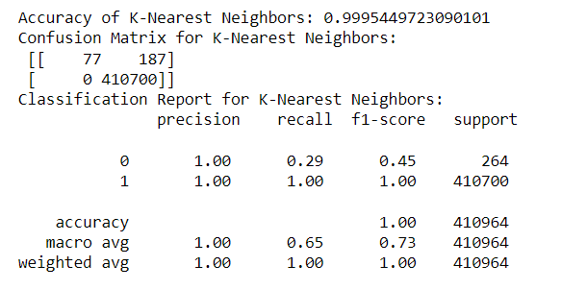
Code and Evaluation

Slide 19
XGBoost
XG boost is the most efficient and scalable implementation of the gradient boosting framework. It is called extreme Gradient Boosting.
It can handle large datasets quickly.
Robust to missing values and provides built-in regularization to prevent overfitting.
It can do parallel computation.
Using ‘xgboost’ library to build the model
Setting up model with parameters like objective, n_estimators, learning_rate, max_depth, subsample and colsample_bytree.
Advantages for Xgboost are highly scalable and effective in predictive accuracy.
Limitations of Xgboost are can be overfitted in the prediction if not properly modeled, careful tuning of parameters are required for best performance.

Slide 20
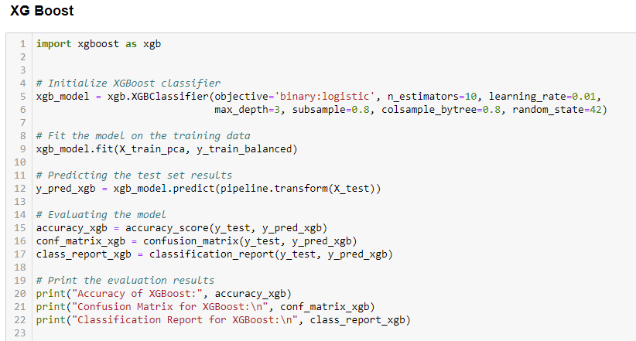
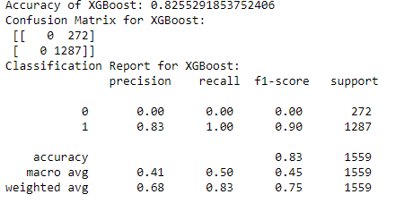
Code and Evaluation for n_estimators = 10

Slide 21
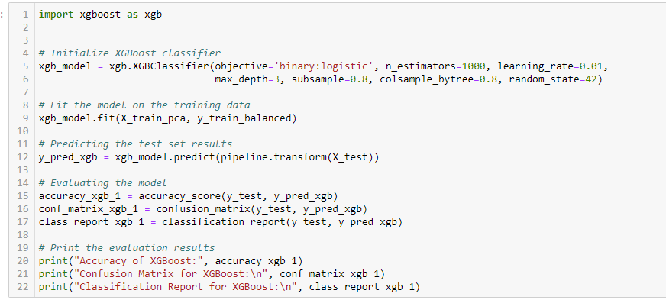
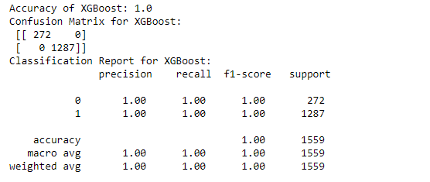
Code and Evaluation for n_estimators = 1000

Slide 22
SVM
Support vector machine(SVM) is a powerful supervised machine learning algorithm that works by finding a hyperplane that divides a dataset into classes.
SVM performs well for the datasets which have more features than samples.
Efficient because it uses subsets of data points to construct individual decision functions or support vectors.
Using Python library sklearn.svm to import the SVM classifier.
This model gives excellent classification metrics.
Limitations are model can be overfitting when several features far exceed the number of samples and are computationally expensive. So, this model is not recommended for large datasets.

Slide 23
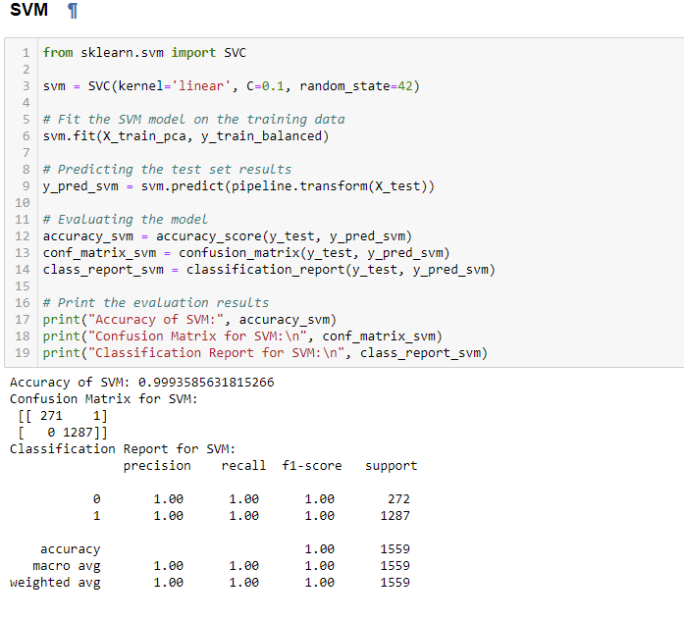
Code and Evaluation for SVM

Slide 24
Decision Tree
Decision trees are a type of supervised learning algorithm that is used for classification. It is in a tree structure.
Simple to understand and evaluate.
less data preparation
Can handle numerical and categorical data.
Using Python library sklearn.tree we can import DecisionTreeClassifier.
Model setup using parameters to control complexity of the model.
Advantages - use for risk analysis, recommendation systems and diagnostic tools.
Limitations are can be prone to overfit with more complex trees as it learns bias also. Can be biased towards features with more levels.

Slide 25
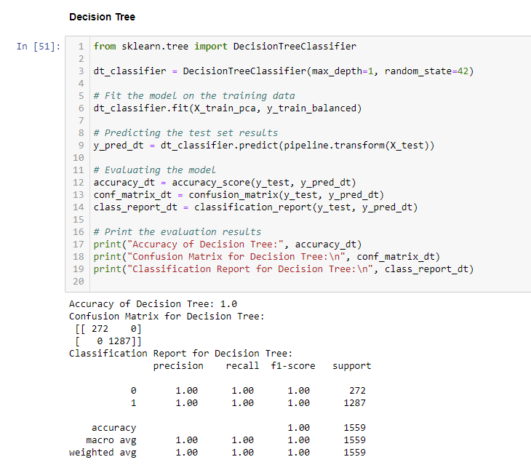
Baseline Decision Tree Model

Slide 26
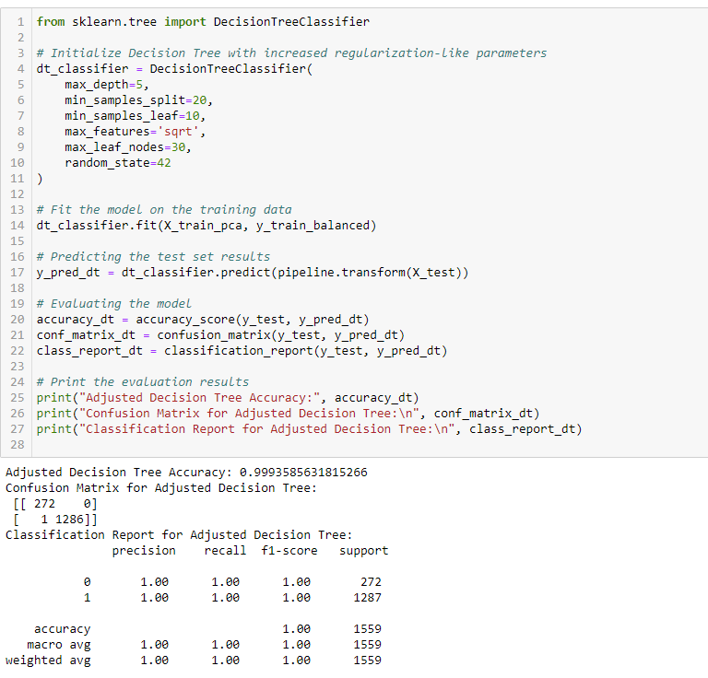
Hyperparameter-tuned model for Decision Tree

Slide 27
Model Evaluations Comparision
Model | Accuracy
Logistic Regression | 1
Logistic Regression with Regularization | 0.828
Random Forest Classifier | 1
RF with hyperparameter tuned | 1
XGBoost | 0.83
KNN Classifier | 0.995
SVM | 1
Decision Trees | 1

Slide 28
Conclusion:
Logistic Regression: Showed perfect accuracy initially, which was reduced to 82.33% after regularization, suggesting initial overfitting.
Random Forest Classifier: Demonstrated high accuracy and robustness to overfitting, making it particularly effective for handling large datasets with high dimensionality.
K-Nearest Neighbors (KNN): Achieved an impressive accuracy of 99%, highlighting its effectiveness despite its simplicity and minimal training phase.
XGBoost: Initially provided an accuracy of 82.55%, which was optimized to 100% when estimators were changed to 100.
Support Vector Machine (SVM): Maintained a consistent accuracy of 100%, indicating excellent performance.

Slide 29
Conclusion(cntd):
The adaptive machine learning models deployed have significantly improved DDoS detection rates and reduced false positives.
Among the models tested, Random Forest and XGBoost were standout performers due to their robustness to overfitting and ability to handle large datasets with high dimensionality. These models proved to be scalable and effective, making them suitable for practical applications in network security.
While all models showed high accuracy, the K-Nearest Neighbors and Support Vector Machine models demonstrated particularly high effectiveness.
To further enhance detection capabilities, a hybrid approach combining multiple models should be used. Such strategies can leverage the strengths of individual models, potentially increasing the overall system's reliability and accuracy.

